Slide 1
Question Evaluator and Recommender
Cristian del Toro
David Ávila
Factored Training Program

Slide 2
Overview
Motivation
EDA and pre-process of dataset
Proposed models and results (hyperparameters and metrics)
Final results and interpretability
Rest API (served in Docker)
Conclusions
Future work

Slide 3
Overview
Motivation
EDA and pre-process of dataset
Proposed models and results (hyperparameters and metrics)
Final results and interpretability
Rest API (served in Docker)
Conclusions
Future work

Slide 4
1. Motivation
Quality of question above standards
How to know if my question would have the expected answers from the community?
Better questions, better answers
How to improve my question to get better answers?

Slide 5
Overview
Motivation
EDA and pre-process of dataset
Proposed models and results (hyperparameters and metrics)
Final results and interpretability
Rest API (served in Docker)
Conclusions
Future work

Slide 6
2. EDA
Initial considerations
The following dataset library was considered: https://archive.org/details/stackexchange
Within this library, the following datasets were considered for the model development:
Stack Overflow (20M questions approx)
English Language (100k questions approx)
Math (60k approx)
GloVe pre-trained word embeddings of 300d
TensorHub pre-trained Word embeddings (Google), 128d

Slide 7
2. EDA
Labels proposed for questions
Two main procedures to label the questions were proposed:
Classification based on median score of questions: Based on median score, classify between "good" or "bad" questions.
Classification based on a linear interpolation of scores of questions: Instead of just considering the median directly of scores, it was considered and interpolation between the scores in order to reduce the huge gap between a very good question (> 300) and a regular question that was being classified as good (> 1).

Slide 8
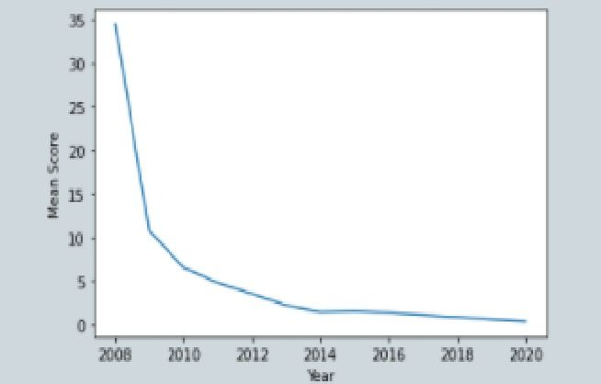
2. EDA
Time-Score dependency

Slide 9
2. EDA –> Pre-process
Dataset cleaning and parsing
Limitations: Large datasets that do not fit in memory
All punctuations and non-alphanumeric characters were removed
From the information of a question, the following were considered during training:
Title: The question itself
Tags: Questions tags referring to the topic of the question
Year: The year where the question was made
Final Label (Binary score 0/1): Given the high time-dependency of each question, the score of a question was found compared to the median interpolation of that year

Slide 10
2. EDA –> Pre-process
GloVe pre-trained embeddings
It was considered the pre-trained embeddings given the Common Crawl model with 42B tokens, vectors with 300 dimensions.
Limitations:
Stack Overflow: It was found that, out of the 20M questions, 97% of the total words were found in the embeddings and 82% of the questions had all the words withing the vocabulary.
English: All words from the dataset were found inside the word embeddings, so 100% of the words had a pre-trained embedding.

Slide 11
2. EDA –> Pre-process
Train-Validation-Test Split
Stack Overflow dataset:
“Heavy” dataset: 6M for training, 18k for validation and testing
“Light” dataset: 900k for training, 5k for validation and testing
English dataset:
“Heavy” dataset: 90k for training, 5k for validation and testing
“Light” dataset: 30k for training, 2k for validation and testing
Math dataset:
“Heavy” dataset: 58k for training, 3.5k for validation and testing

Slide 12
Overview
Motivation
EDA and pre-process of dataset
Proposed models and results (hyperparameters and metrics)
Final results and interpretability
Rest API (served in Docker)
Conclusions
Future work

Slide 13
Baseline Model: Simple RNN

Slide 14
3. Baseline Model: Simple RNN
Hyperparameters:
Input shape: (30, 300) tensors for each question, 30 as MAX LENGTH and 300 as DIM EMBEDDING
3 hidden layers: Two Bidirectional LSTM layers were considered (each with 128 units) and one extra Flatten layer.
ReLU activation for last layer: As it was intended to create a regression model, final score was further classified if above or below median.
Adam Optimizer (rate = 0.001) and MSE for loss function
Metrics:
Mean Absolute Error
Results:
Given the high Bayes error (noisy dataset) and the lack of complexity, the model performed like “guessing” with the score of highest probability. Accuracy: 0.55

Slide 15
Model Iterations

Slide 16
3. Naïve Bayes
A very different approach was considered using a Naive Bayes model to classify the questions between good and bad questions, like the well-known Sentiment Analysis model. The model, given its simplicity to load large data faster, was run with different datasets and the accuracy of the train set is presented as follows
Light Dataset
2010 (34629-1885, Title): 0.5899
2010 (34629-1885, Title, Tags): 0.6053
2010 (34629-1885, Title, Body, Tags): 0.5825
2010-2011 (94322-5138, Title): 0.6137
2010-2011 (94322-5138, Title, Tags): 0.6306
2010-2011 (94322-5138, Title, Body, Tags): 0.6146
Heavy Dataset
2010 (622987-34610, Title): 0.5899
2010 (622987-34610, Title, Tags) : 0.6316
2010-2011 (1696396-94244, Title): 0.6256
2010-2011 (1696396-94244, Title, Tags): 0.6315
2010-2019 (Title, Tags): 0.6022

Slide 17
3. k-NN classification
Using the similar equations, the mean score was calculated within the k nearest questions and that is the prediction to make. The model itself uses a Bert sentence embeddings pre-trained model in order to find vectors and cosine similarity was applied to find the k-nearest neighbors.
Input dataset:
51.5% good questions, 48.5% bad questions
Hyperparameters:
Input shape: (768) vectors for each question, 768 as DIM BERT EMBEDDING
K: Validation tests were run for K within the range [5,15]
Metrics:
Binary Classification Accuracy
Results:
Best K parameter: 8. Accuracy: 0.58

Slide 18
3. Complex RNN Model - Stack
Most complex model considered in order to train, using data generators, for “Heavy” dataset of Stack Overflow (6M questions)
Hyperparameters:
Input shape: (30, 300) vectors for each question, 300 as DIM EMBEDDING
Sigmoid activation for last layer: Intended to binary classification of questions
Adam Optimizer (rate = 0.003) and Binary CrossEntropy for loss function
Batch Size: 512
Epochs: 10
Input dataset:
55.1% good questions, 44.9% bad questions
Metrics:
Accuracy
Validation Set (using generators)
Results:
Accuracy: 0.65

Slide 19
3. Complex RNN Model - Math
Most complex model considered in order to train, using data generators, for “Heavy” dataset of Math (60k questions)
Hyperparameters:
Input shape: (20, 128) vectors for each question, 128 as DIM EMBEDDING
Sigmoid activation for last layer: Intended to binary classification of questions
Adam Optimizer (rate = 0.0003) and Binary CrossEntropy for loss function
Batch Size: 1024
Epochs: 20
Input dataset:
51% good questions, 49% bad questions
Metrics:
Accuracy
Validation Set (using generators)
Results:
Accuracy: 0.685 -> using body of question
Accuracy: 0.664 -> without body of question

Slide 20
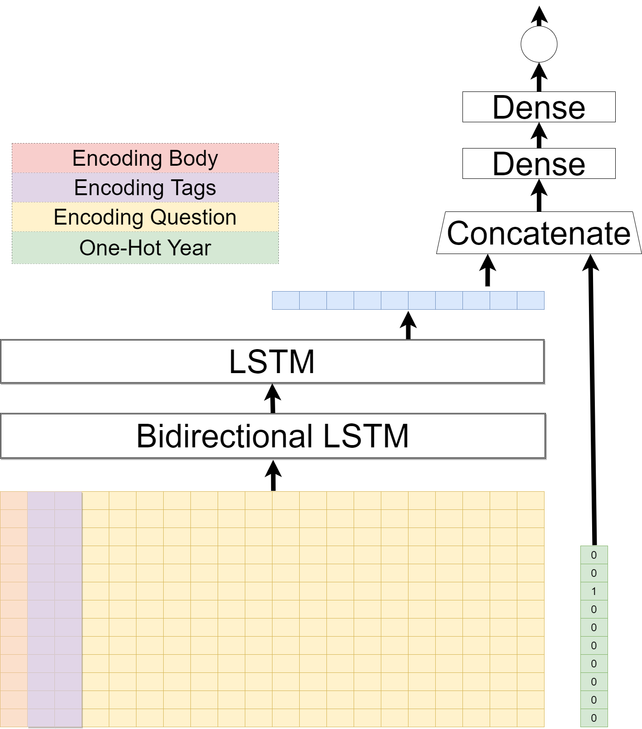
3. Complex RNN Model - Math

Slide 21
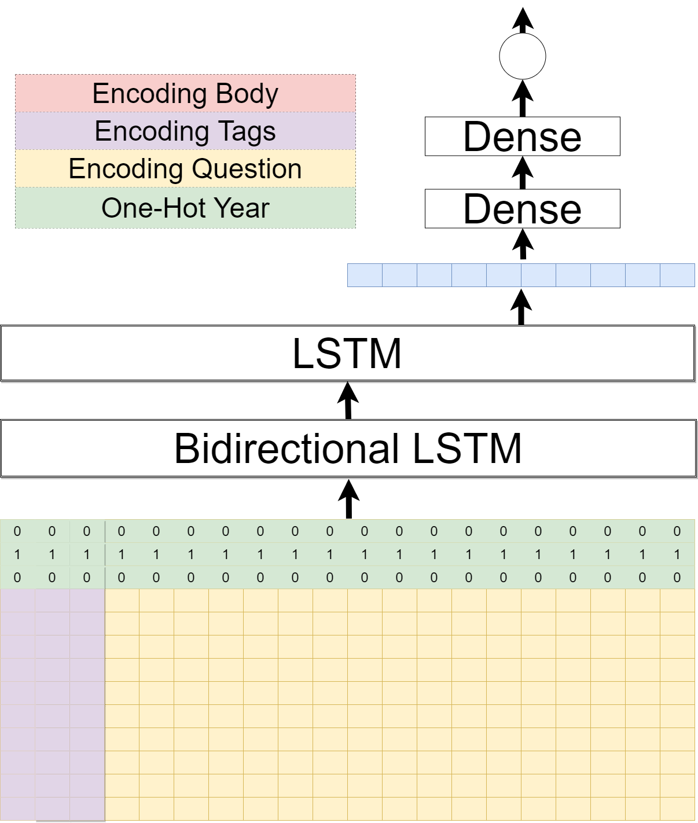
3. Complex RNN Model - Math

Slide 22
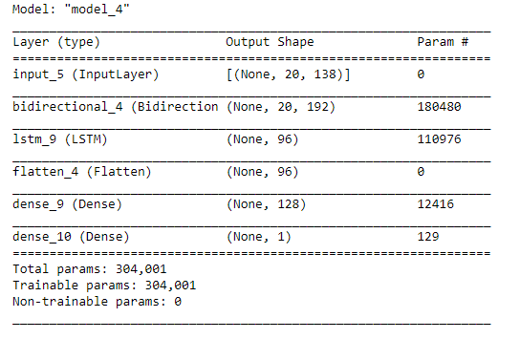
3. Complex RNN Model - Math

Slide 23
Overview
Motivation
EDA and pre-process of dataset
Proposed models and results (hyperparameters and metrics)
Final results and interpretability
Rest API (served in Docker)
Conclusions
Future work

Slide 24
4. Final Results / Interpretability
Model Selected:
The model with Math dataset, 128 dim embeddings (Google from TensorHub) had an accuracy of 0.685 with body of question and 0.664 without body.
Interpretability:
As part of the results, the Integrated Gradients module (alibi API) was used in order to find the relevance of each of the words on the questions.
Results shown in next slides

Slide 25
Overview
Motivation
EDA and pre-process of dataset
Proposed models and results (hyperparameters and metrics)
Final results and interpretability
Rest API (served in Docker)
Conclusions
Future work

Slide 26
5. REST API
Endpoint 1: Prediction with just the question
Docker Image created with NN model serving on localhost port 5000

Slide 27
5. REST API
Endpoint 2: Prediction with question, year and tags
Docker Image created with NN model serving on localhost port 5000

Slide 28
Overview
Motivation
EDA and pre-process of dataset
Proposed models and results (hyperparameters and metrics)
Final results and interpretability
Rest API (served in Docker)
Conclusions
Future work

Slide 29
6. Conclusions
Very noisy/varied-distributed dataset
Given the highest time-score dependency on the data, we can conclude that each year has its own distribution and considering all data (from 2008, foundation of Stack Exchange, up to 2020) could lead to unreliable predictions
Model complexity improves the performance, but further preprocessing is needed to diminish the year-distribution data
As mentioned, the complex RNN considered improved the performance but it still can be improved if some preprocessing is made in order to avoid the different distributions on the data per year.
Word embeddings with OOV handling are needed
For the processing of “informal“ text, as it is the case of internet forums, word embedding techniques that account for OOV words are a must. Dictionary-like word embeddings are more appropriate for text data proceeding from cleaner sources, like books and articles

Slide 30
Overview
Motivation
EDA and pre-process of dataset
Proposed models and results (hyperparameters and metrics)
Final results and interpretability
Rest API (served in Docker)
Conclusions
Future work

Slide 31
6. Future Work
Complex NN architectures
Given how specialized is the vocabulary in every sub forum, it may be convenient to prepare a set of word embeddings for every one of them, either by fine tuning a pre-trained embedding, or training one from the beginning for the forums with enough data. The use of newer, state of the art models such as BERT can be explored given enough time.
Consider traditional grammar quality
Providing such detailed feedback on the influence that every word has on the final prediction, could lead the users to unintentionally “trick“ the model with unnaturally posed questions rather than higher quality ones (an involuntary adversarial attack)
Improve OOV encoding and depper NN
Consider another encoding that can handle OOV words using subwords (such as FastText from Facebook). Also, considering a deeper NN in order to tune the hyperparameters more in depth.
Train harder for feedback rather than score
The quality of feedback can improve if an “artificial task” is defined. Greater accuracy on score does not mean better feedback for question. Additional research would be required to find a quantitative approach to evaluate the feedback quality.

Slide 32
Cristian del Toro David Ávila Factored Training Program

